Slide 1
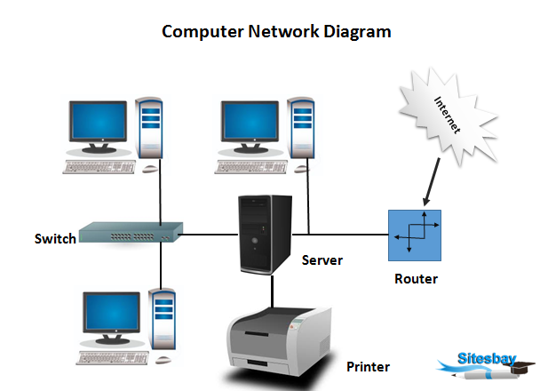
Introduction of computer network
Computer network a collection of computing devices that are connected in various ways in order to communication and share resources.
Usually the connections between computers in a network are made using physical wires or cable however, some connections are wireless or using radio waves (Bluetooth).

Slide 2
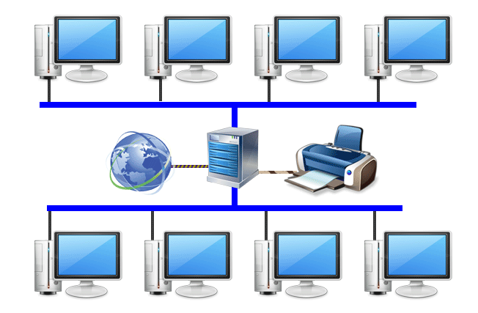
Advantages of network
1. Resource such as printers, scanners easily shared with multiple devices.
2. Storage sharing also becomes possible.

Slide 3
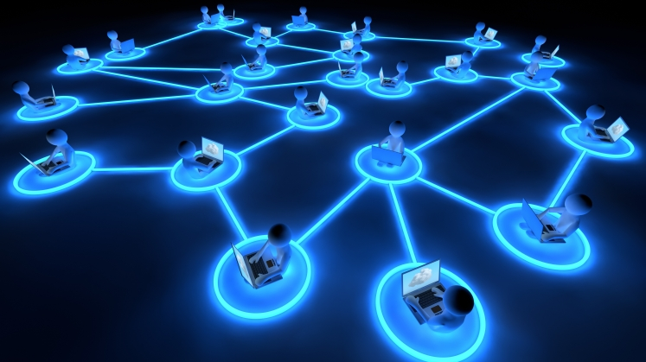
3. It also provide us the way to store share software.
.
4. It also provide us a way to improve communication.

Slide 4
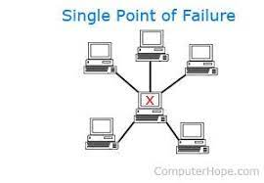
Disadvantages of network
1. The system becomes more sophisticated and complex.
2. In case of central server fail, every communication failed.

Slide 5
Types of network

Slide 6
Types of area networks
LAN - Local area network
CAN – campus area network
VLAN – virtual local area network
MAN - metropolitan area network
WAN - wide area network

Slide 7
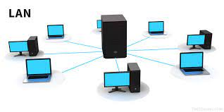
Local area network (LAn)
A local area network (LAN) consists of a series of computers linked together to form a network in a location. The computers in a LAN connect to each other via TCP/IP ethernet or Wi-Fi. A LAN is normally exclusive to an organization or building , such as a school, office.

Slide 8
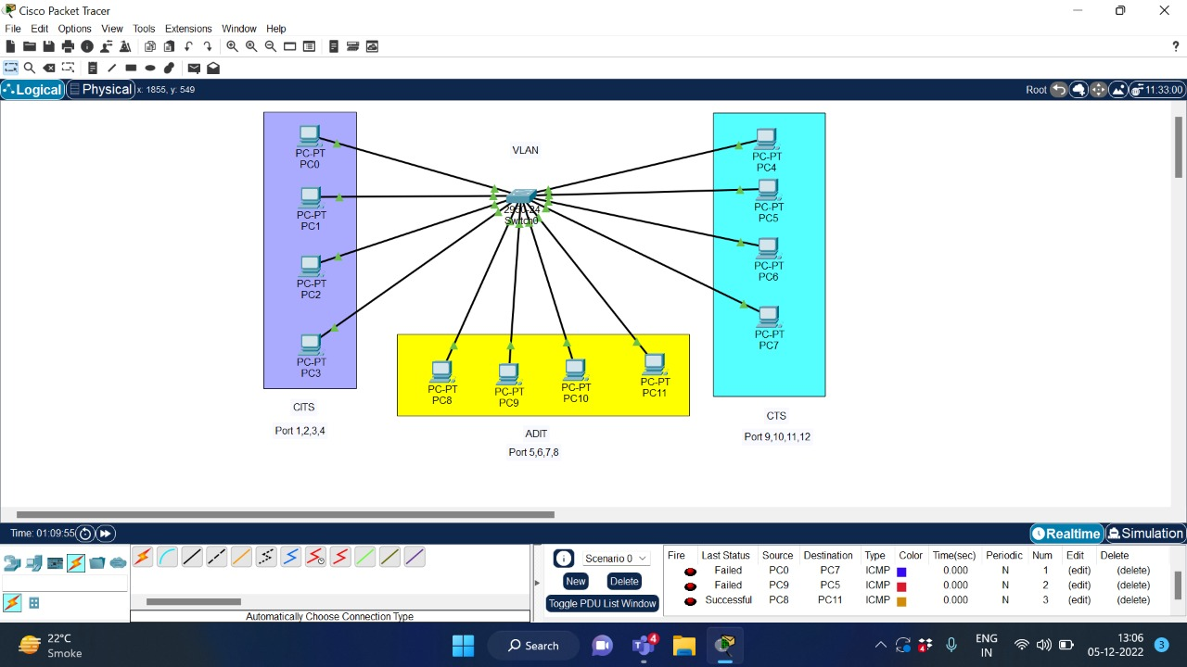
Virtual local area network (vlan)
VLANs allow network administrators to automatically limit access to a specified group of users by dividing workstations into different isolated LAN segments. When users move their workstations, administrators don't need to reconfigure the network or change VLAN groups.

Slide 9
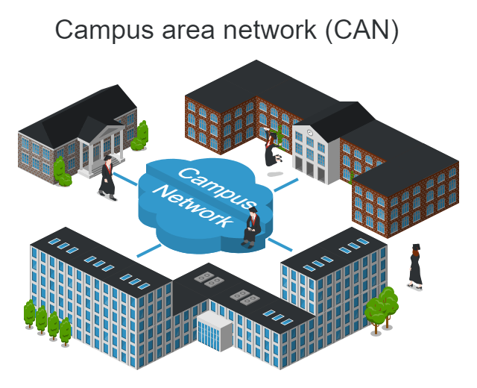
Campus area network (can)
A campus area network (CAN) is a computer network that spans a limited geographic area. CANs interconnect multiple local area networks (LAN) within an educational or corporate campus. Most CANs connect to the public Internet.

Slide 10
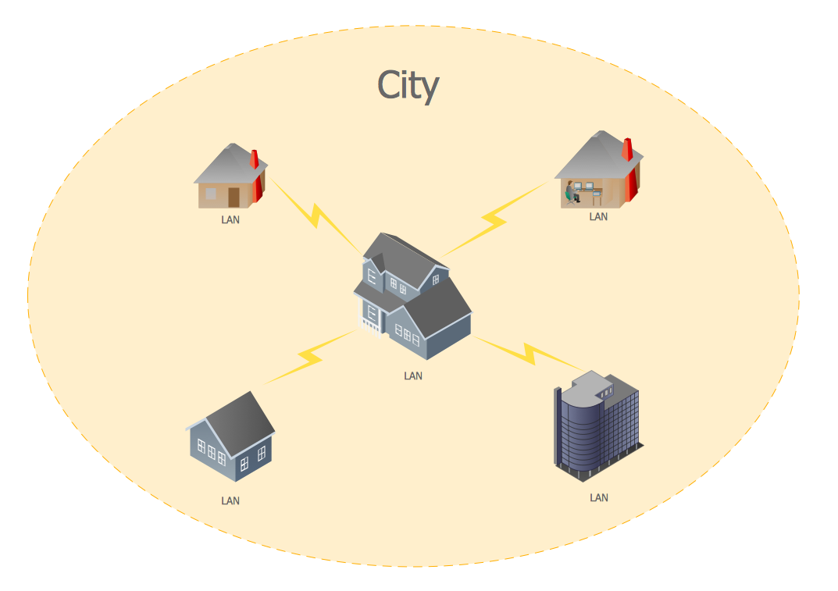
metropolitan area network (MAN)
A metropolitan area network (MAN) is a computer network that connects computers within a metropolitan area, which could be a single large city, multiple cities and towns, or any given large area with multiple buildings. A MAN is larger than a local area network (LAN) but smaller than a wide area network (WAN).

Slide 11
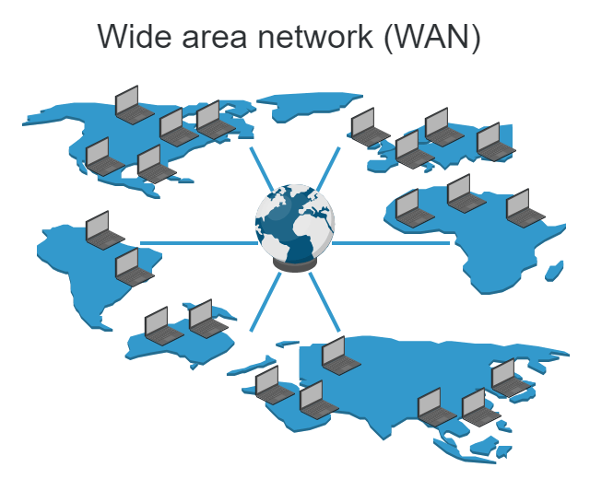
Wide area network (wan)
WANs have a large capacity, connecting a large number of computers over a large area, and are inherently scalable. They facilitate the sharing of regional resources. They provide uplinks for connecting LANs and MANs to the Internet.

Slide 12
Differences of Lan man wan
LAN
MAN
WAN
use- Building, school, office, house.
_________________________
Range- 10 miter to 1000 miter.
_________________________
Connect- Ethernet, wifi Bluetooth.
Use- multiple building, city.
_________________________
Range- 5 kilometer to 50 kilometer.
_________________________
Connect- cable.
Use- multiple city, country.
_________________________
Range- 1 lac kilometer.
_________________________
Connect- internet.

Slide 13
Internet, intranet, and extranet

Slide 14
What is internet
INTERNET- inter + net= inter - interconnected + net – network.
It is a networks of network that includes millions of privet and public, academic business and government networks (local or global), linked by copper wire wireless connections and other technologies.

Slide 15
Applications of internet
Download programs and files
E-mail
Voice and video conferencing
E-commerce
File sharing
Information browsing
Search the web address for access through search engine
Catting and many more

Slide 16
What is intranet
It is a privet network. Internal company network that uses intranet standard (HTML, HTTP & TCP/IP) & software.
Accessed only by authorized persons, especially members or employees of the organization.

Slide 17
Applications of intranet
Sharing of company policies/rules & regulations
Access employee database
Distribution of information of common interest
Access product and customer data
Submission of reports
Corporate telephone directories

Slide 18
What is extranet
Extranet is an intranet for outside authorized users using same internet technology.
Inter-organizational information system
Enable outsiders to work together with company’s employees.
Open to selected suppliers, customers & other business partners.

Slide 19
Examples..
Dealers/distributors have access to product files such as
Product specification
Pictures
Images etc.
To answer the queries of the customers.

Slide 20
Thank you ☺

